Slide 1
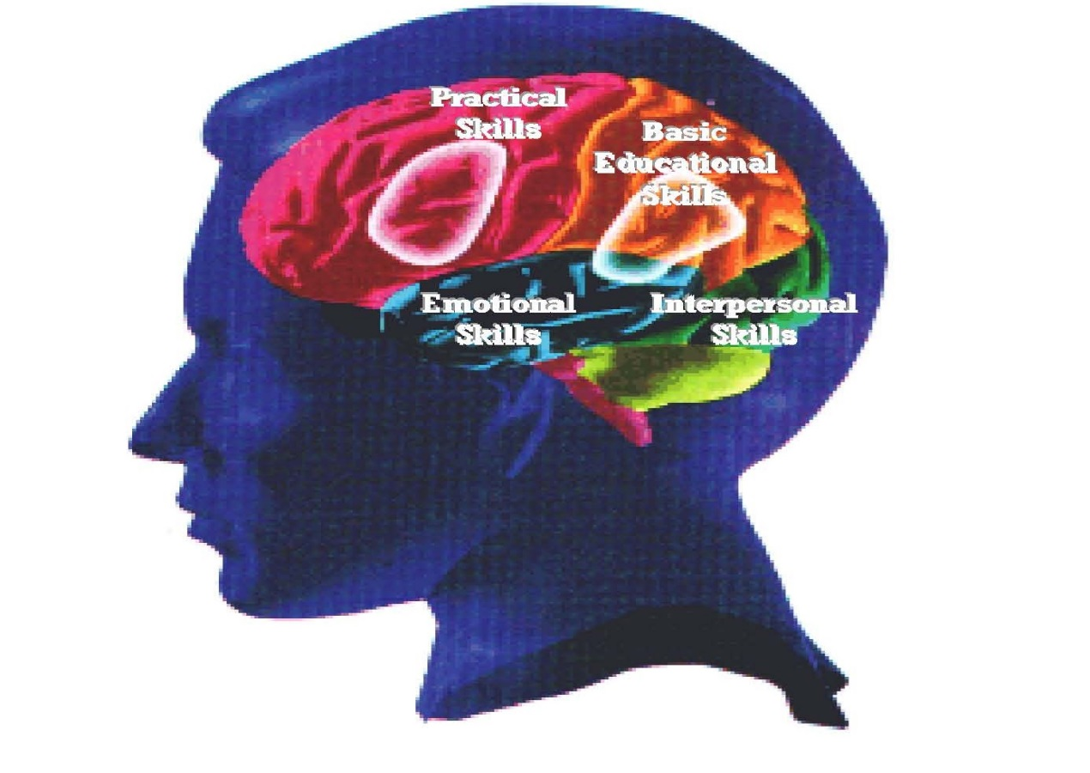
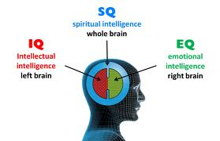
Intelligence
Dr J Balamurugan

Slide 2
Introduction of intelligence
Intelligence has been defined in many different ways including logic, abstract thought, understanding, self-awareness, communication, learning, having emotional knowledge, planning and problem solving.
Intelligence is most widely studied in human, but has also been observed in animals and in plants.
Within the discipline of Psychology, various approaches to human intelligence have been adopted.

Slide 3
Definition of Intelligence
According to Weshler,
Intelligence is the aggregate or global capacity of the individual
to act purposefully,
to think rationally, and
to deal effectively with his environment.

Slide 4
Components of Intelligence
Understand complex ideas
Adapt to the environment
Learn from experience
Ability to learn
Problem solving skills

Slide 5
Intelligence and Human Diversity
Gender
Overall, men and women do not differ significantly in general intelligence
Women may show slight advantage in mathematical computation skills
Men show an advantage in spatial ability
Men are more likely to fall in the extremes of intelligence range
Culture
Difference in academic performance between American and Asian students are found from first grade through high school in mathematics and reading
May be related to a difference in cultural attitudes toward ability and effort

Slide 6
Early Theories of Intelligence
Charles Spearman
Believed intelligence is general
People who are bright in one area are usually bright in other areas as well
L. L. Thurstone
Believed that intelligence is made up of seven distinct independent abilities
Spatial ability, perceptual speed, numerical ability, verbal meaning, memory, word fluency, and reasoning
R. B. Cattell
Identified two clusters of Intelligence
Crystallized intelligence includes abilities such as reasoning and verbal skills
Fluid intelligence includes skills such as spatial and visual imagery, rote memory, and the ability to notice visual details
While education can increase crystallized intelligence, it was not thought to have any effect on fluid intelligence

Slide 7
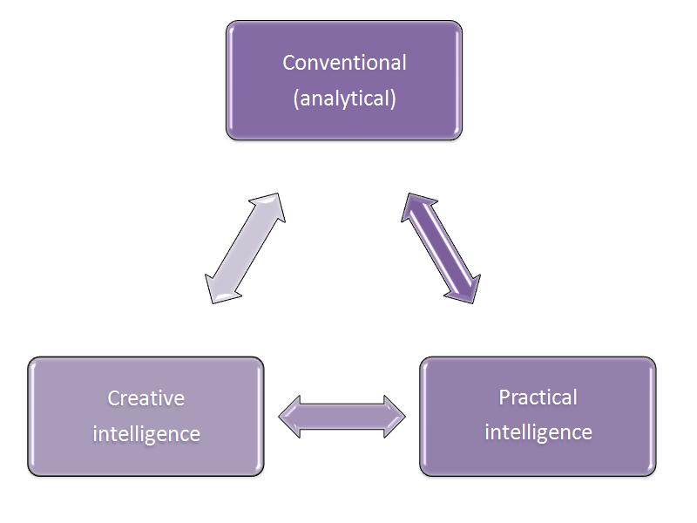
Contemporary Theories of Intelligence
Robert Sternberg
Triarchic theory of intelligence posits three types of intelligence
Analytical intelligence includes the ability to learn how to do things, solve problems, and acquire new knowledge
Creative intelligence includes the ability adjust to new tasks, use new concepts, and respond well in new situations
Practical intelligence includes the ability to select contexts in which you can excel and solve practical problems

Slide 8
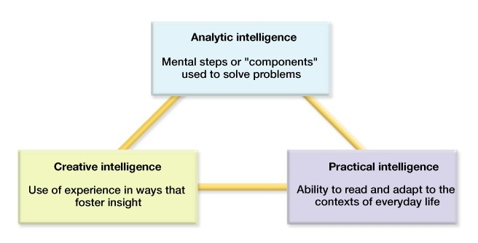
Triarchic theory of intelligence

Slide 9
Contemporary Theories of Intelligence
Daniel Goleman
Proposed Theory of Emotional Intelligence
It refers to the ability to perceive, control, and evaluate emotions
Emotional intelligence has five components
Knowing one’s own emotions
Managing one’s own emotions
Using emotions to motivate oneself
Recognizing the emotions of other people
Managing relationships

Slide 10
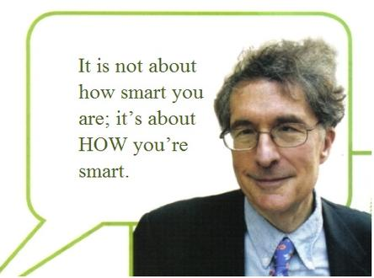
Contemporary theories of intelligence
Howard Gardner’s theory of Multiple Intelligences
The theory of multiple intelligences has encouraged the idea that a person is not born with all the intelligence they will ever possess.

Slide 11
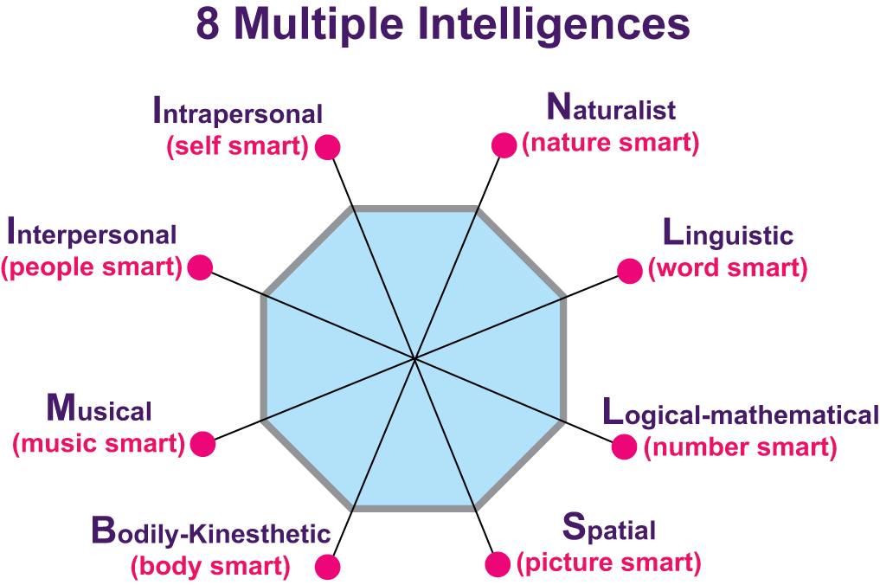

Slide 12
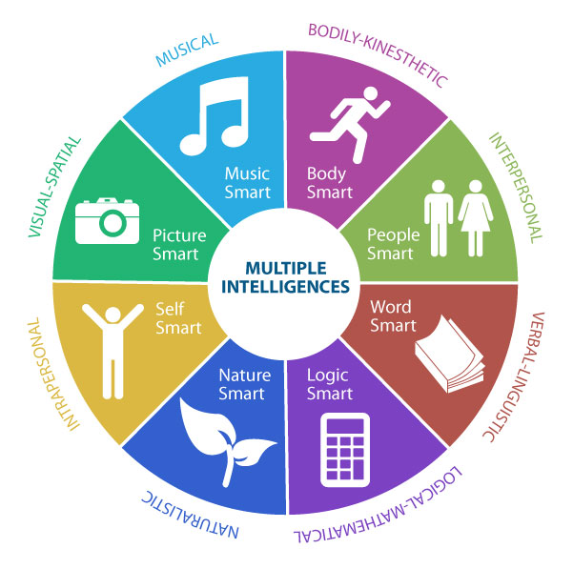

Slide 13
Gardner’s Theory of Intelligence
*Naturalistic
*Verbal/ Linguistic
*Visual/ Spatial
*Interpersonal
*Musical/ Rhythmic
*Logical/ Mathematical
*Intrapersonal
*Bodily/ Kinesthetic

Slide 14
Naturalistic intelligence
The ability to discriminate among living things as well as sensitivity to other features of the natural world.
These individuals are said to be highly aware of even subtle changes to their environments.
Characteristics of Naturalistic Intelligence
Interested in subjects such as botany, biology and zoology
Good at categorizing and cataloging information easily
May enjoy camping, gardening, hiking and exploring the outdoors
Doesn’t enjoy learning unfamiliar topics that have no connection to nature

Slide 15
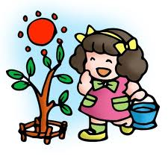
Possible Careers
Biologist
Conservationist
Gardener
Farmer

Slide 16
Linguistic Intelligence
Linguistic Intelligence (Word Smart) is the capacity to use language, (your native language and perhaps other languages), to express what's on your mind and to understand other people.
Criteria Used for Linguistic Intelligence
Can understand words and manipulate the structure of language
Has highly developed communication skills including writing, speaking, and story-telling
Knows and correctly uses rules of grammar
Enjoys reading, writing, and speaking
Has a large vocabulary

Slide 17
Possible Careers
These people would do well in these careers.
Author
Journalist
Poet
Playwright
Radio Announcer
Speech Pathologist (one who interprets)
Typist
Novelist
Comedian
Politician
Actor

Slide 18
Activities These People Would Enjoy
Book reporting
Telling jokes
Writing words
Reading
Journal writing
Speaking
Letter writing
Storytelling
Discussing
Creative writing
Debating

Slide 19
Logical-Mathematical Intelligence
Logical-mathematical intelligence is the capacity to use numbers effectively and reason well.
Someone who has this kind of intelligence is able to see cause and effect really well; also, they are able to identify a problem and solve it right there on the spot.
People with this intelligence think by reasoning, and they love experimenting, questioning, figuring out logical puzzles, and calculating.

Slide 20
Possible Careers
Economist
Legal Assistant
Mathematician
Purchasing Agent
Science Researcher
Science Teacher
Statistician
Technician
Accountant
Auditor
Banker
Book keeper
Business person
Computer Analyst
Computer Programmer
Doctor

Slide 21
spatial intelligence
Spatial intelligence is the brain’s ability to perceive and interpret visual stimuli.
In other words, it’s how our minds process what we see.
Although not very recognized, spatial intelligence is very important in the arts and in everyday life.

Slide 22
Possible Careers
Advertising Agent
Architect
Cartographer (Map Maker)
Drafter
Engineer
Fine Artist
Graphic Designer
Fashion Designer
Interior Designer
Inventor
Painter
Photographer
Pilot
Sculptor
Surveyor
Urban Planner

Slide 23
Bodily-Kinesthetic Intelligence
It is expertise in using one’s whole body to express ideas and feelings.
Examples: acting, dancing, sports, and using body language
It is the ability to use one’s hands to produce or transform things.
Examples: sculpting clay and hands-on learning

Slide 24
Possible Careers
Inventor
Jeweler
Mechanic
Mime
P.E. Teacher
Physical Therapist
Recreational Director
Actress
Actor
Athlete
Carpenter
Choreographer (creates and arranges dances)
Craftsman
Dancer
Forest Ranger

Slide 25
Musical Intelligence
Being musically intelligent means that you are able to distinguish the sounds around you and that you have the ability to make your own melodies.
Even if you are only singing a song or making music, you are using your musical intelligence!

Slide 26
Possible careers
• Song Writer
• Performing Musician
• Piano Turner
• Singer
• Musical Theater Actor/ Actress
• Studio Engineer
• Instrument Manager
Advertising Agent
Conductor
Film/Instrument Maker
Composer
Music Teacher
Sound Engineer
Music Therapist

Slide 27

Interpersonal Intelligence
Interpersonal intelligence, (people smart), is understanding other people.
It’s an ability we all need, but is at a premium if you are a teacher, clinician, salesperson, or a politician.
Anybody who deals with other people has to be skilled in the interpersonal intelligence.

Slide 28
possible Careers
Public Relations
Salesperson
School Principal
Sociologist
Therapist
Teacher
Travel Agent
Religious Leader
Psychologist
Administrator
Anthropologist
Counselor
Manager
Nurse
Personnel Director
Politician

Slide 29

Interpersonally intelligent people likes
Understanding other's feelings
Person-to-person communication
Cooperative learning strategies
Receiving feedback
Group projects
Teaching someone else something new
Learning from someone outside of school
Acting in a play or simulation
Conducting an interview
Sensing others’ motives
Creating group rules
Giving feedback to the teacher or to classmates

Slide 30
intrapersonal intelligence
Intrapersonal intelligence is self-knowledge and the ability to act adaptively on the basis of that knowledge.
This intelligence includes having an accurate picture of oneself (one’s strengths and weaknesses); awareness of inner moods, intentions, motivations, temperaments, and desires; and the capacity for self-discipline, self-understanding, and self-esteem. Essentially, it’s how well you know yourself.

Slide 31
Possible careers
• Program planner
• Counsellor
• Psychology Teacher
• Philosopher
• Researcher
• Spiritual Counselor
Psychologist

Slide 32
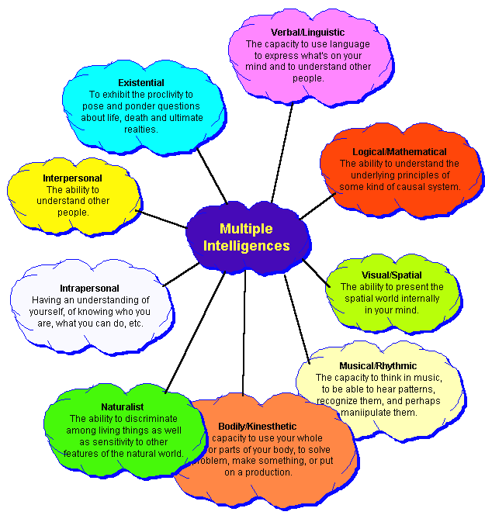

Slide 33
Thank you

